Slide 1
Testing Framework Evidence Draft Copy
Presented By: Michael, Deepak, Barry, Bijaya, Joseph
C# .NET Core Framework
18 Oct 2021

Slide 2
Logging & Reporting Technology
Logging Technology
NLog
Reporting Technology
Extent Reports

Slide 3
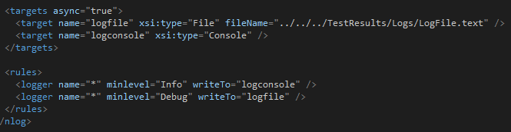
Logging with NLog
The framework has been designed in a way that the logs are saved to a text file instead of the console
There is also a rule that specifies the log level should be set to ‘Info’
The results are stored in a one centralised location ‘TestResults’ folder with its own nested folder called ‘Logs’

Slide 4
Reporting with Extent Reports
The results are all stored in a one centralised location ‘TestResults’ folder with its own nested folder called ‘Reports’
The actual results document is saved as a .html which can be open with any desired browser type
The results capture whether the test has passed or failed.
Extent Reports also provides the abilities to capture the exception and take a picture of the issue and attach it to the Report.
Extents provides the results in 2 formats:
1. Hi-Level dashboard to view all overall general information of the Test Run.
2. Results can also be viewed by Feature with each individual test scenario for that feature being able to be expanded on to view more details of each test step.

Slide 5
Features
The framework currently has one dedicated feature per project layer within the solution except for Test Framework…
Simple API Feature
Automated Testing using Selenium Feature
Database Feature

Slide 6
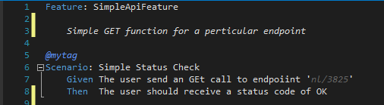
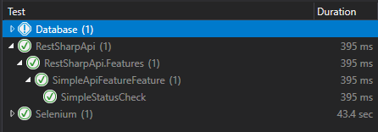
Simple API Feature
This is currently the only feature file for the RestSharp API Project
The feature only consist of 1 Test Scenario;
The 1 Test Scenario will perform a GET operation on the specified endpoint to which an Status of Ok should be returned in the response. Unfortunately this project does not have any Reporting / Logging functionality implemented.

Slide 7
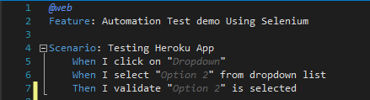
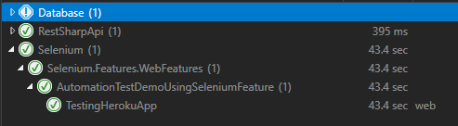
Automated Test Demo Using Selenium Feature
This is currently the only feature for the Selenium Project
This feature file consist of only 1 Test Scenario;
1 Test Scenario will launch the HerokuApp from the appsettings.config file
The script will go to the drop down list section
Select 3 various items from the drop down menu and take a picture of each item and output this to the test result folder.

Slide 8
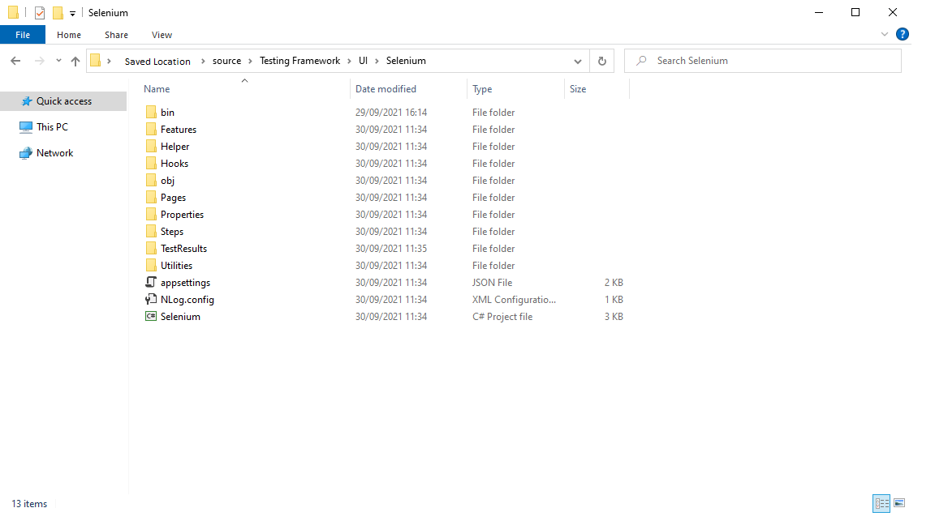
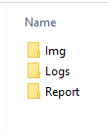
Accessing Results
Results are very easy to view and are all stored in one centralised location within the solution folder.

Slide 9
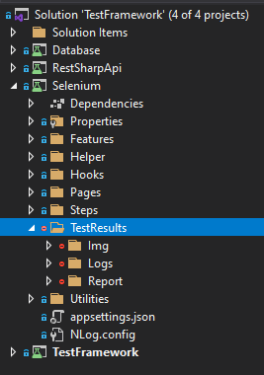
Accessing Results Continued
The folder can also be accessed directly from within the solution whilst in Visual Studios.
Img folder contains the screenshots captured by the framework.
Logs folder contains the Nlog.txt file
Report folder contains the Extent Report

Slide 10
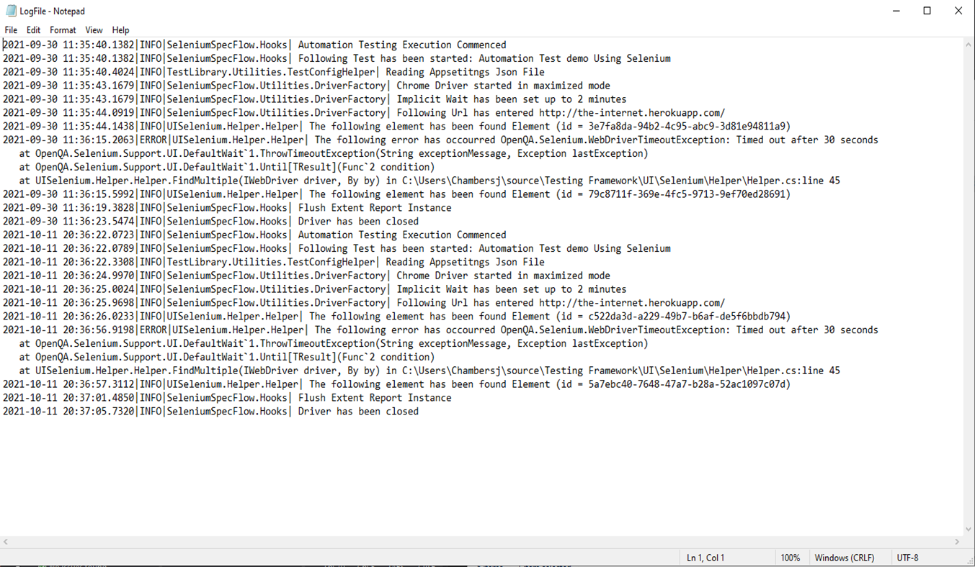
NLog Example to Expect
The log as previously mentioned is at an Info level.
The example displays the capabilities that you can achieve with NLog.
The example also contains an exception that has been logged for demonstrating purposes.

Slide 11
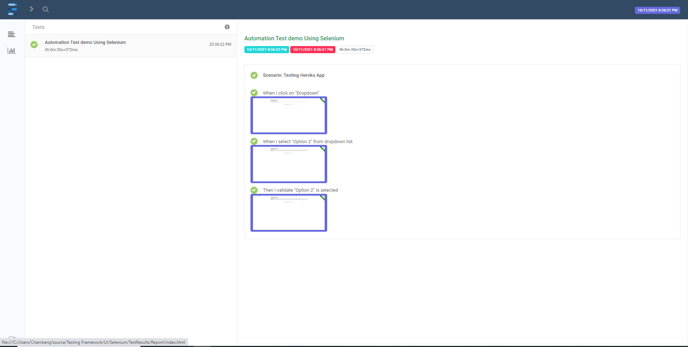
Extent Reports Example
This example has a 100% Pass rate.
All details about the Test run for that Test Scenario are displayed in the example.
You can see the images that were instructed to be taken are displayed as an attachment for each step.

